Slide 1
INFO1112 Tutorial
Week 8

Slide 2
Homework stuff
Homework 3 – Interviews
Homework 4 – due 24th September, 23:59:00 (this Sunday)

Slide 3
Brief summary of this week’s content

Slide 4
8.1 – Domain Name System (DNS)
Recap from Week 6 and 7 that we use the IP protocol to communicate with devices over the internet
Each device is assigned an IP address
Concept of both private and public IP addresses
Private IP addresses – restricted to inside a LAN
Public IP addresses – viewable to entire internet
Mapping from LAN private → public IP addresses performed by NAT
IP addresses are a bit abstract and hard to remember
How can we transform them into a more human readable form?

Slide 5
8.1 – Domain Name System (DNS)
Early internet (ARPAnet) – computers had 24-bit addresses, with each address being mapped to a simple, human-readable text name
Simple names stored in single file (hosts.txt) regularly distributed in network
Only several hundred computers in network
What might be the issues with this single-file approach?
1983 – Domain Name System (DNS) introduced
Rather than a centralised file containing mappings, a distributed system was developed
When a simple name needs to be translated to an IP address, a request is made to a server, which responds with the necessary information

Slide 6
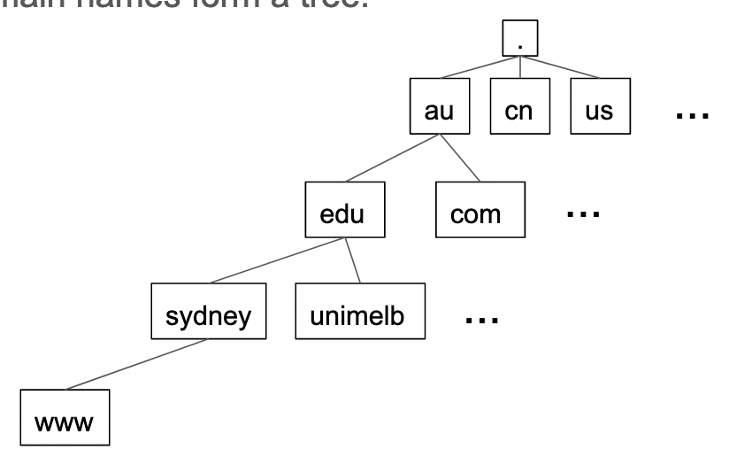
8.1 – Domain Name System (DNS)
Structure of domain names
Hierarchical – similar to file system
Each text section separated by a dot forms a part of this hierarchy
Hierarchy forms a tree
Example: www.sydney.edu.au›
“Dot” represents “root” of the tree (not included in domain name)
Below root is top-level domain name
Used to represent country of registration, e.g. Australia

Slide 7
8.1 – Domain Name System (DNS)
Structure of domain names
Each ”level” represents a “nameserver” that contains information about the level below
Separates each level into various purposes, e.g. “.com” represents commercial, “.edu” – educational

Slide 8


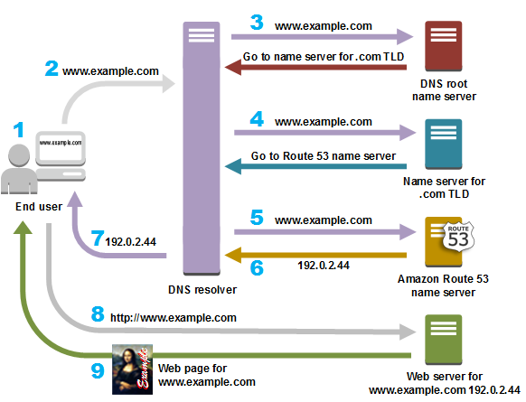

8.1 – Domain Name System (DNS)
Each computer’s network configuration includes
its own IP address in the LAN
the IP address of a nameserver for domain lookups
When a computer looks up a domain name, it asks the configured nameserver for the IP using the DNS protocol
DNS sends messages using Unified Datagram Protocol (UDP) – faster than TCP due to not caring about errors
Configured name server communicates with name servers on each layer to get more information

Slide 9
8.1 – Domain Name System (DNS)
How does a computer get IP and DNS information?
Dynamic Host Configuration Protocol (DHCP) – commonly used protocol to dynamically assign IP addresses in a LAN based on which IP addresses are currently free
When a computer connects to a network, it sends a broadcast packet that requests information from a DHCP server, receiving the computer’s IP address and what DNS server to use

Slide 10
8.1 – Domain Name System (DNS)
Within domain names, each “level” has its own authority which manages the namespace
E.g. sydney.edu.au
“.au” domains are country code top level domains (TLD) managed by auDA
“.edu” Sections of a domain level authority can become “delegated subzones” to be managed by education Australia
“Sydney” finally all Sydney.edu.au websites can be edited, created and managed by Sydney.edu.au (USYD)

Slide 11

8.1 – Domain Name System (DNS)
Name | Full domain name of node in domain tree
Type | Type of record
Class | What ”class” of connection this record belongs to (generally “IN”) for internet)
TTL | Time to live in seconds before record expires
Data Length | Length of data field below
Data | Value of record
DNS database contains DNS resource records containing information related to the name:
Contents:

Slide 12
8.2 – Application Protocols
Recap: application layer protocols are highest layers of Internet Protocol Suite
Dictates the standards in how individual applications can communicate with each other
email software
web pages and websites
text/video chat services
Examples:
HyperText Transfer Protocol (HTTP) – for transmitting web pages
Simple Mail Transfer Protocol (SMTP) – for sending emails
These protocols are generally text-based
Anyone, including yourself, could implement an application layer protocol

Slide 13
8.2 – Application Protocols
Recap: Transmission Control Protocol (TCP)
Used to ensure packets are transmitted correctly by performing error detection and correction
On top of the existing IP address, TCP connections contain a port
16-bit number that defines a specific connection point on a machine
Analogy: IP address is like a building, and ports are like doors
Applications can attach themselves to ports
Many ports are reserved, however, a large number are available for general use
HTTP has port 80 reserved
SMTP has port 25 reserved

Slide 14
8.2 – Application Protocols
HTTP
When a client wants to fetch a web page, it sends a GET request to the web server, specifically to port 80
Web server looks in database of web pages and fetches the web page the client wants
Web server sends the result of the request back, and if successful, the HTML code of the desired webpage
Example of request:
Client
GET /index.html HTTP/1.1
Server
HTTP/1.1 200 OK
<html>
<head>
<title>My Webpage</title>
</head>
...

Slide 15
8.2 – Application Protocols
SMTP
Client determines mail server IP from the DNS MX record (indicating mail exchange)
Connection made to mail server
Server sends initial status message
Client responds with request to fetch mail items
Server responds with mail items

Slide 16
8.2 – Application Protocols
SMTP
General standard for email messages is Multipurpose Internet Mail Extensions (MIME)
Email follows specific structure as shown:
MIME can not only carry text data, but other information as well (such as file attachments)
From: "Bob Example" <bob@example.com> To: Alice Example <alice@example.com> Cc: theboss@example.com Date: Tue, 15 January 2008 16:02:43 -0500 Subject: Test message Hello Alice. This is a test message with 5 header fields and 4 lines in the message body. Your friend, Bob .
indicates end of message

Slide 17
Bonus: Broadcasting messages
A broadcast IP address is a specific address used to send data to all devices in a particular network segment.
It's a way to address data to multiple network devices simultaneously instead of sending to each one individually.
How can we find this?
the ifconfig command will provide the broadcast IP for a connected network, labelled broadcast, and written as hexadecimal
IP address of computer on LAN
IP address of broadcast IP address
Localhost IP (Restricted to network of your own device)

Slide 18
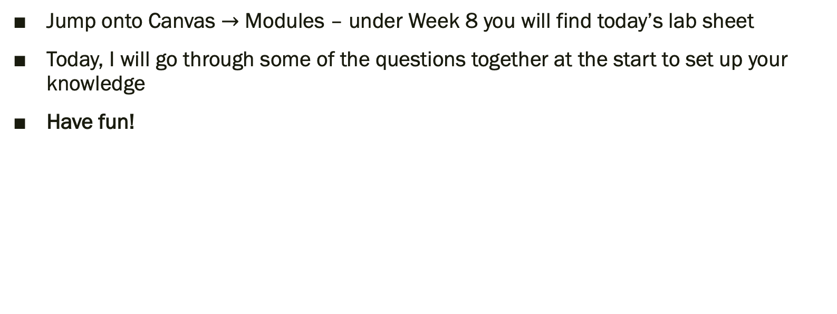
Lab exercises
Jump onto Canvas $→$ Modules – under Week 8 you will find today’s lab sheet
Today, I will go through some of the questions together at the start to set up your knowledge
Have fun!

